Slide 1




GALAXY CUP
View in Power BI
BY:-
TANISH KOHLI
This Photo by Unknown Author is licensed under CC BY

Slide 2
PROBLEM STATEMENT
The biggest tournament of the decade, The Galaxy Cup, is just months away from commencing and the biggest concern right now is to select a strong playing 11 and a few promising backup players to play for our planet Earth and win the greatest T20 cricket tournament.

Slide 3
SELECTION CRITERIA
Galaxy Cup is a T20 tournament hence we will be making all the decisions based only on the basis of T20 World Cup 2022 as it is the biggest competition in the world and involves high-pressure matches, therefore is ideal to select our playing 11 and rest of the squad.
The Playing 11 should have 2 opening batsmen with great strike-rate and power-hitting ability, 3 middle order batsmen who can anchor the innings and build partnerships, 1 finisher who can smash the ball around the park and can be handy in bowling as well, 2 spin bowling all-rounders with a low economy and some batting skills, and 3 fast bowlers can give breakthroughs and concede minimum runs.

Slide 4
SELECTION MEASURES
OPENING BATSMAN
BATTING STRIKE RATE > 140
BATTING AVERAGE > 30
BOUNDARY % > 50
AVERAGE BALLS FACED > 15
MIDDLE ORDER
BATTING STRIKE RATE > 125
BATTING AVERAGE > 40
BOUNDARY % > 40
AVERAGE BALLS FACED > 20
FINISHER
BATTING STRIKE RATE > 130
BATTING AVERAGE > 25
BOUNDARY % > 50
AVERAGE BALLS FACED > 12
SPIN ALL-ROUNDERS
ECONOMY < 7
BOWLING STRIKE RATE < 20
BATTING STRIKE RATE > 130
BATTING AVERAGE > 15
FAST BOWLERS
ECONOMY < 7.2
BOWLING STRIKE RATE < 16
DOT BALL% > 40
BOWLING AVERAGE > 17

Slide 5
The T20 World Cup dataset was taken from Kaggle and includes all the necessary data of every match held during the championship, the dataset contains tables such as Batting Summary, Bowling Summary, Players Profile, and Match Summary.
Data cleaning and minor Data Transformation were done using Python and Pandas.
Majority of the Data Transformation was performed using Power Query in Power BI.
Data Modelling and Parameter Building were completed using DAX in Power BI. It included creating all the measures that were important to select the team.
Finally the data was analyzed and visualized on the Power BI Desktop and the final report was published on Power BI Service.
NOTE:-
The following slides are only images of the actual report. To visualize the report better kindly open this link.
The Cards on display such as batting style and player role are on default settings and hence do not tell the information of any player on screen.

Slide 6
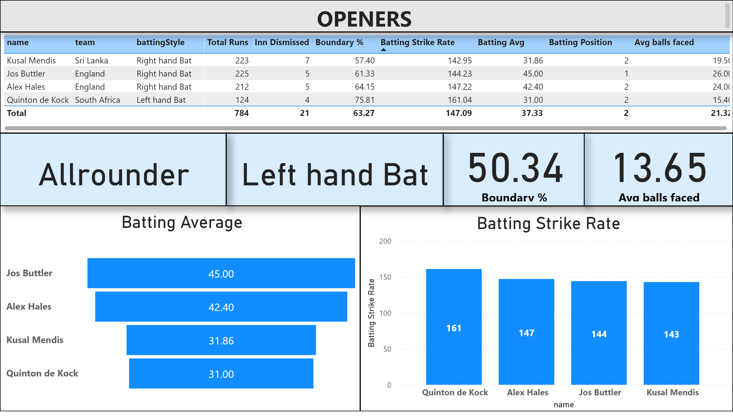
OPENERS
Notes:
tableEx
No alt text provided
Batting Average
No alt text provided
Batting Strike Rate
No alt text provided
card
No alt text provided
card
No alt text provided
textbox
No alt text provided
card
No alt text provided
card
No alt text provided

Slide 7
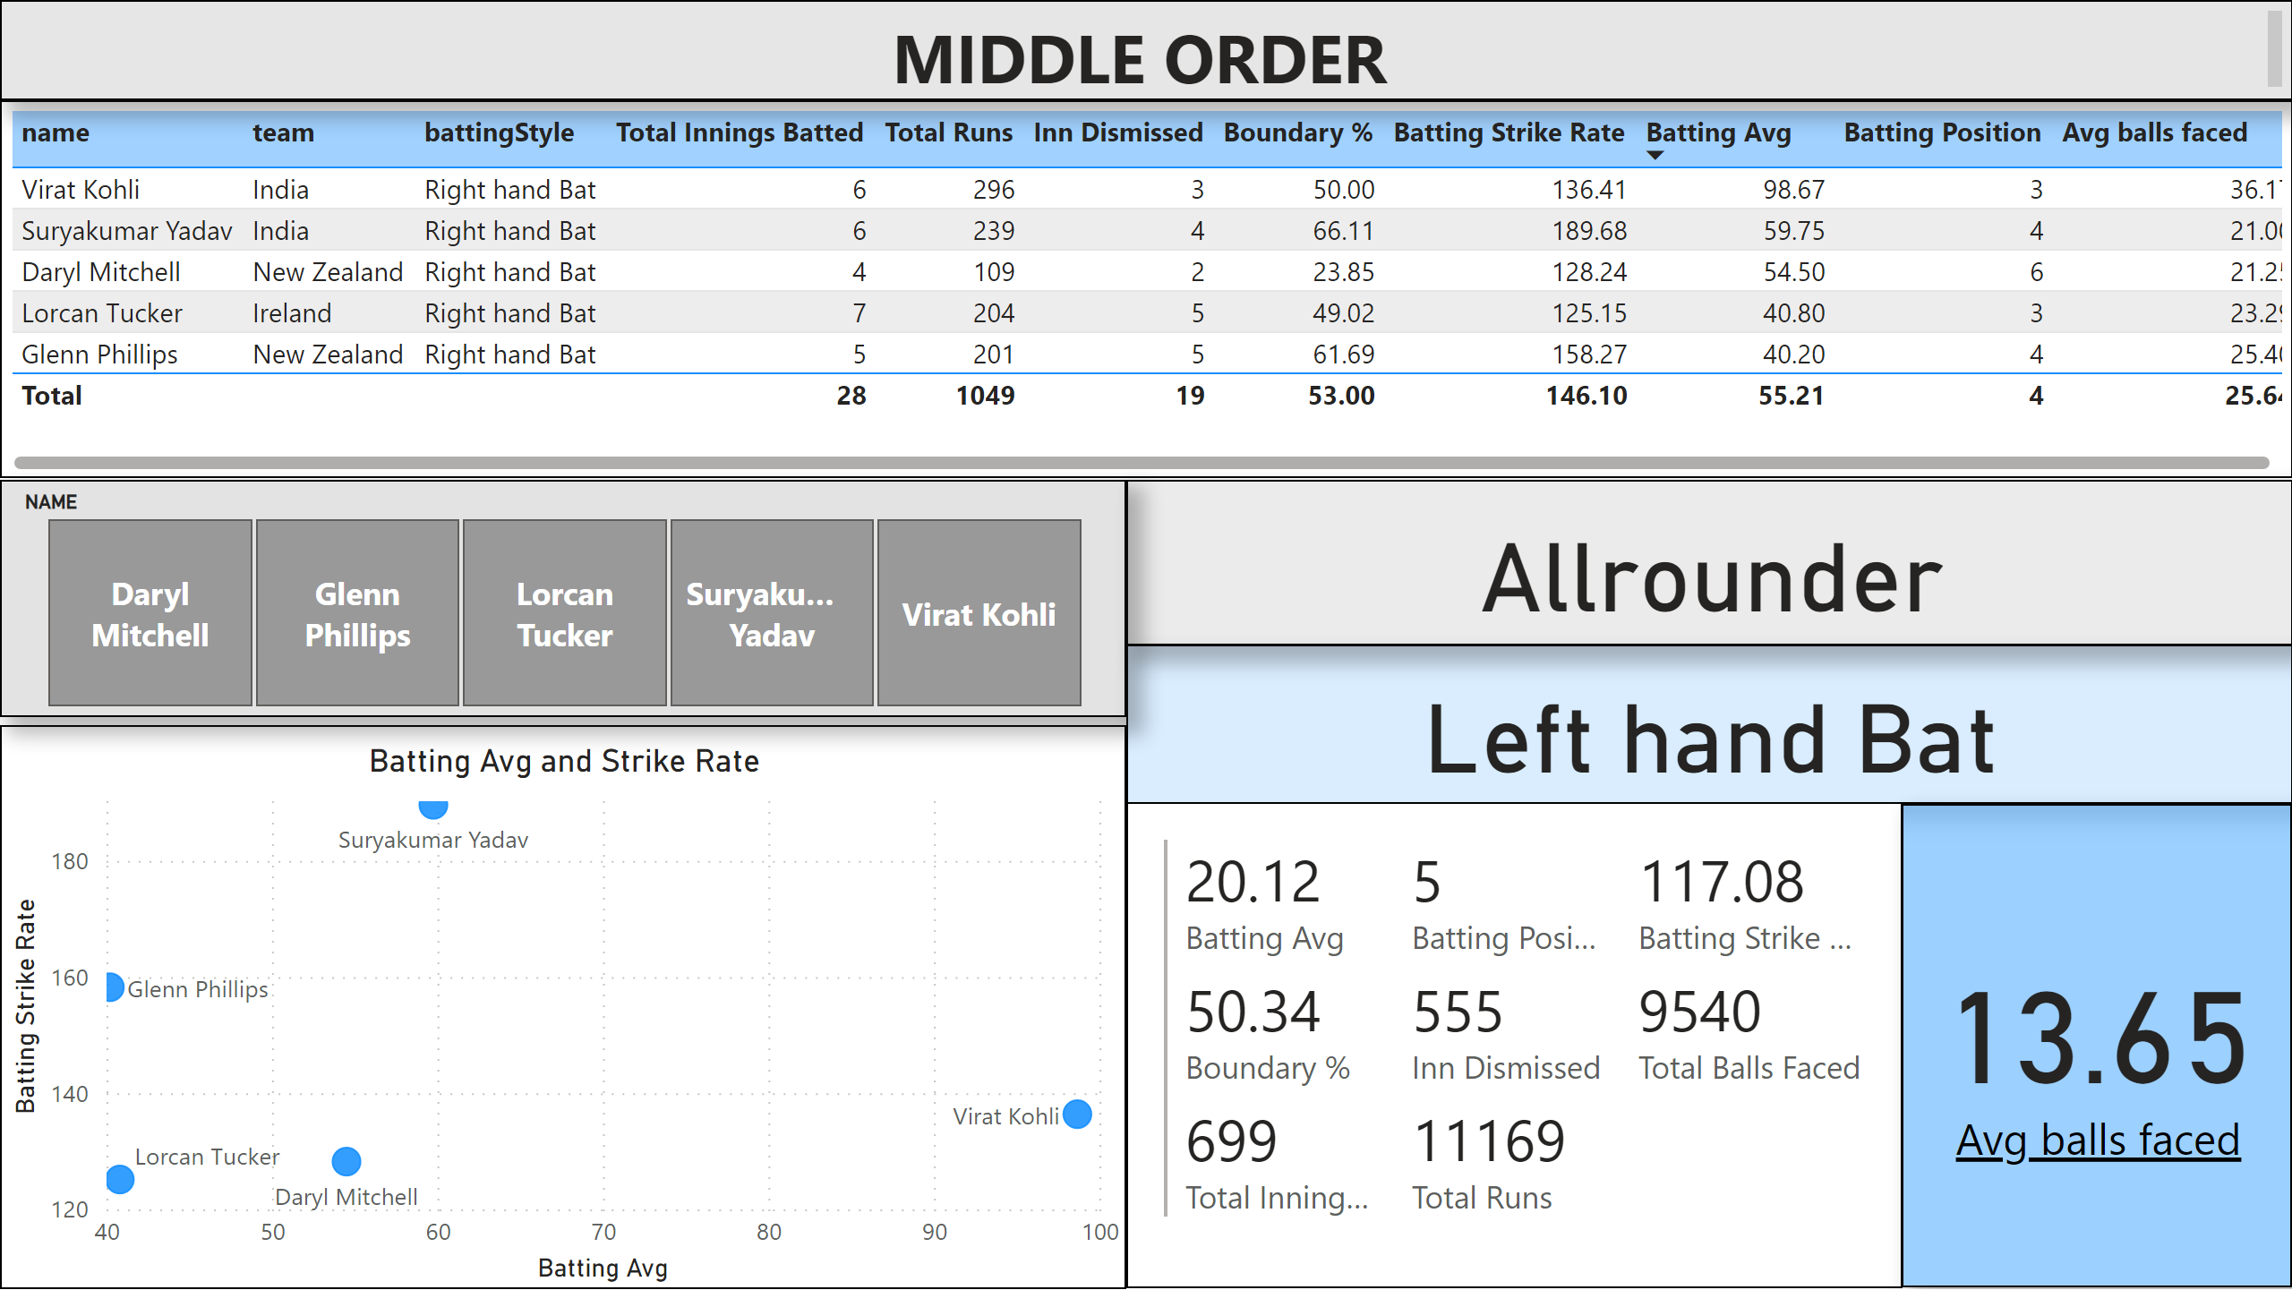
MIDDLE ORDER
Notes:
tableEx
No alt text provided
card
No alt text provided
textbox
No alt text provided
Batting Avg and Strike Rate
No alt text provided
multiRowCard
No alt text provided
card
No alt text provided
card
No alt text provided
slicer
No alt text provided

Slide 8
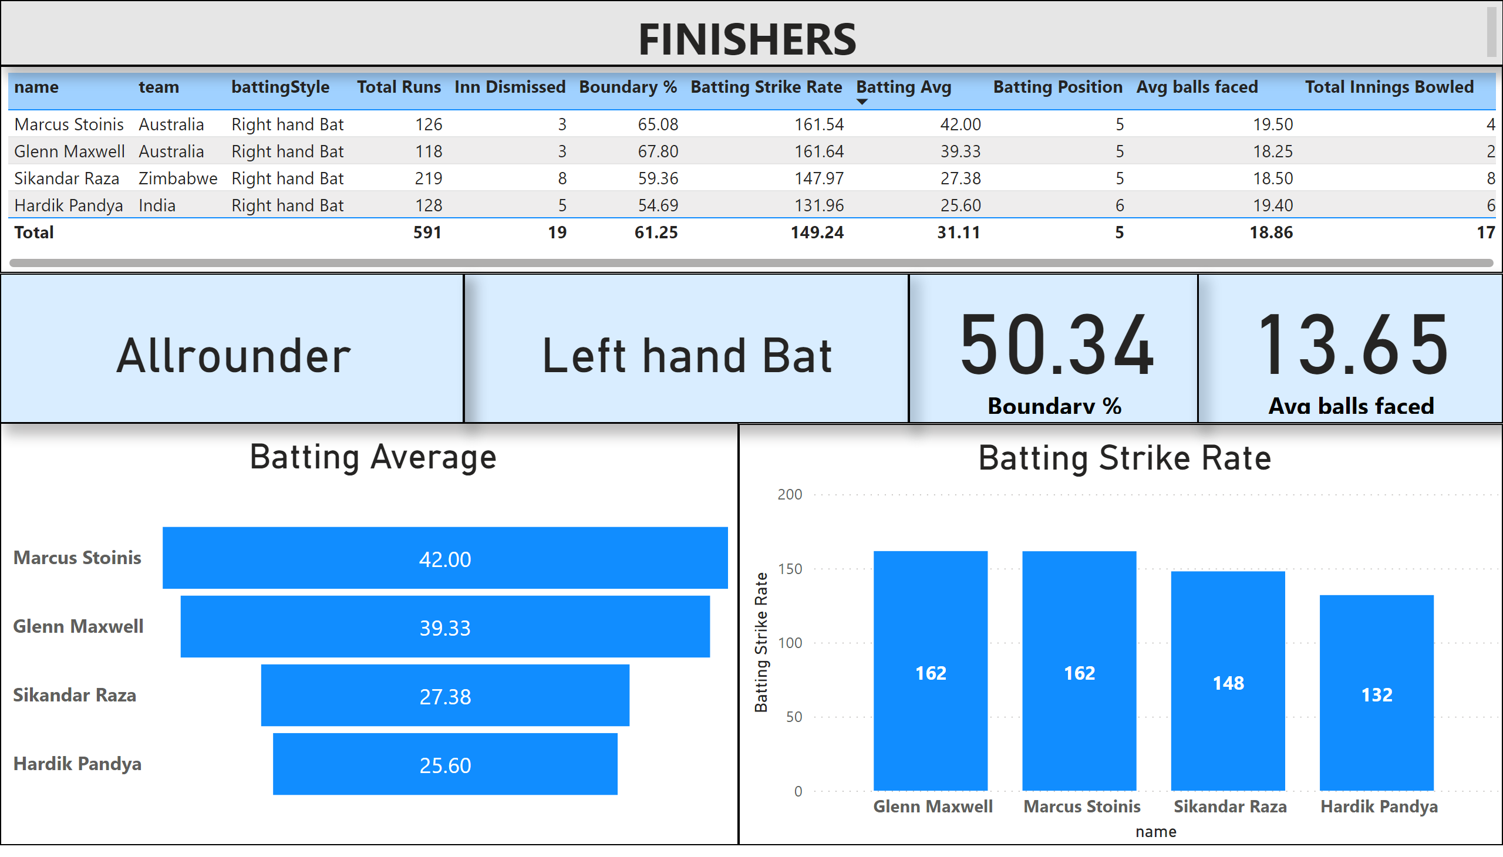
FINISHERS
Notes:
tableEx
No alt text provided
Batting Average
No alt text provided
Batting Strike Rate
No alt text provided
card
No alt text provided
card
No alt text provided
textbox
No alt text provided
card
No alt text provided
card
No alt text provided

Slide 9
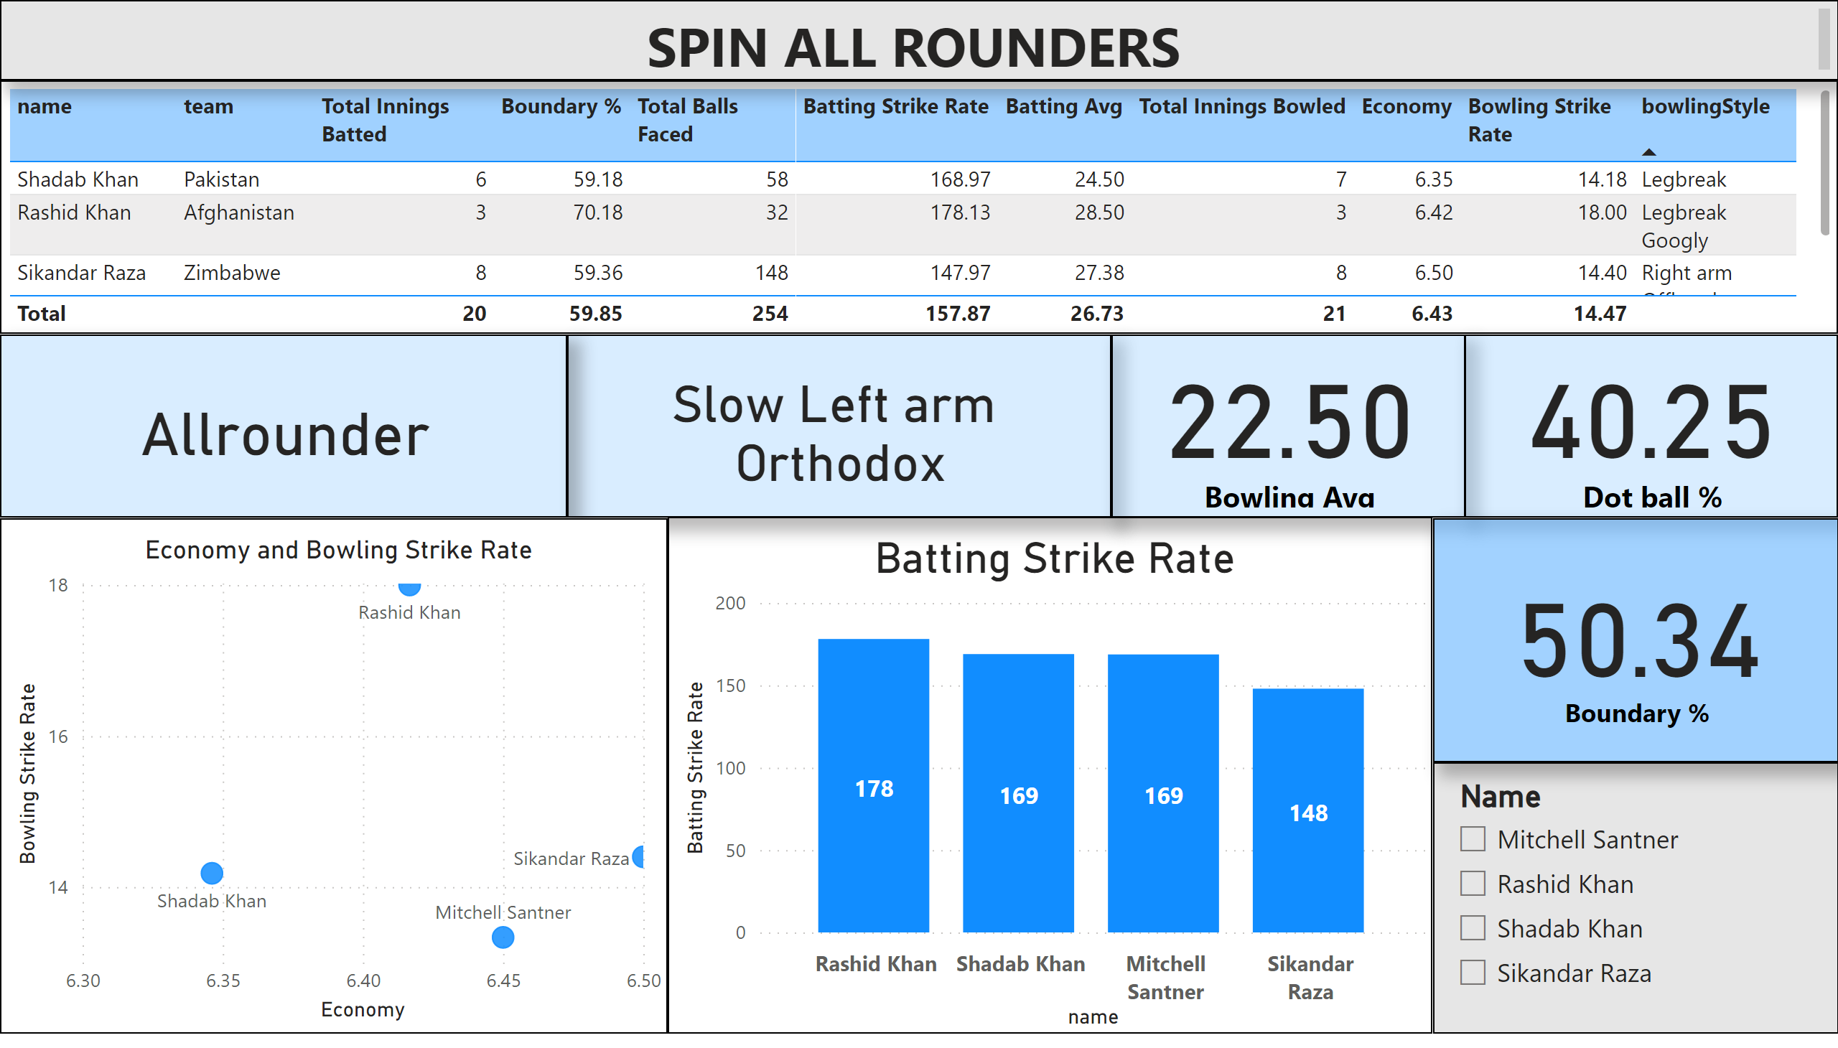
SPIN ALL ROUNDERS
Notes:
tableEx
No alt text provided
Batting Strike Rate
No alt text provided
card
No alt text provided
card
No alt text provided
textbox
No alt text provided
card
No alt text provided
card
No alt text provided
Economy and Bowling Strike Rate
No alt text provided
slicer
No alt text provided
card
No alt text provided

Slide 10
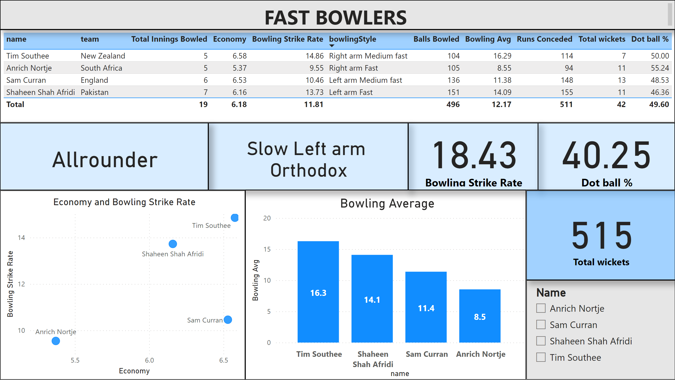
FAST BOWLERS
Notes:
tableEx
No alt text provided
Bowling Average
No alt text provided
card
No alt text provided
card
No alt text provided
textbox
No alt text provided
card
No alt text provided
card
No alt text provided
Economy and Bowling Strike Rate
No alt text provided
slicer
No alt text provided
card
No alt text provided

Slide 11
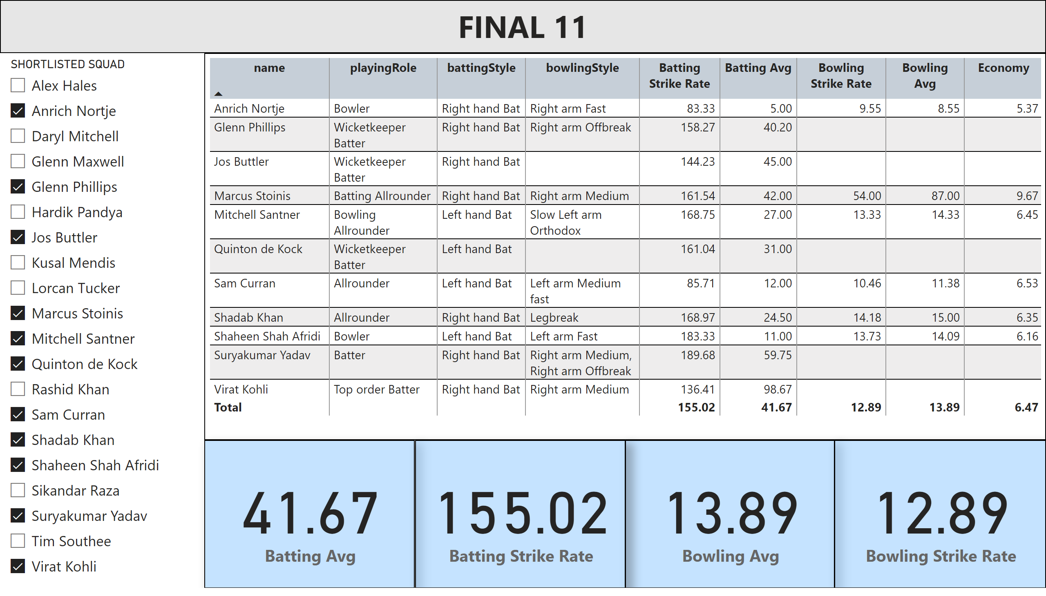
FINAL 11
Notes:
textbox
No alt text provided
tableEx
No alt text provided
slicer
No alt text provided
card
No alt text provided
card
No alt text provided
card
No alt text provided
card
No alt text provided

Slide 12
BACK UP PLAYERS
PLAYING 11
PLAYER NAME | BATTING POSITION
JOS BUTTLER (WK) | 1
QUINTON DE COCK | 2
VIRAT KOHLI © | 3
SURYA KUMAR YADAV | 4
GLENN PHILIPS | 5
MARCUS STOINIS | 6
MITCHEL SANTNER | 7
SHADAB KHAN | 8
SAM CURRAN | 9
ANRICH NORTJE | 10
SHAHEEN SHAH AFREEDI | 11
ALEX HALES
KUSAL MENDIS
DARYL MITCHELL
LORCAN TUCKER
GLENN MAXWELL
HARDIK PANDYA
RASHID KHAN
SIKANDAR RAZA
TIM SOUTHEE

